Slide 1
Synod Assembly 2015

Slide 2
LEAD and ELECTIONS

Slide 3
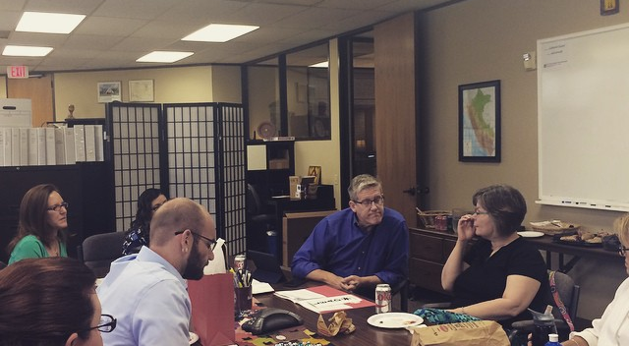
IMMIGRATION, LIRS, LWR

Slide 4
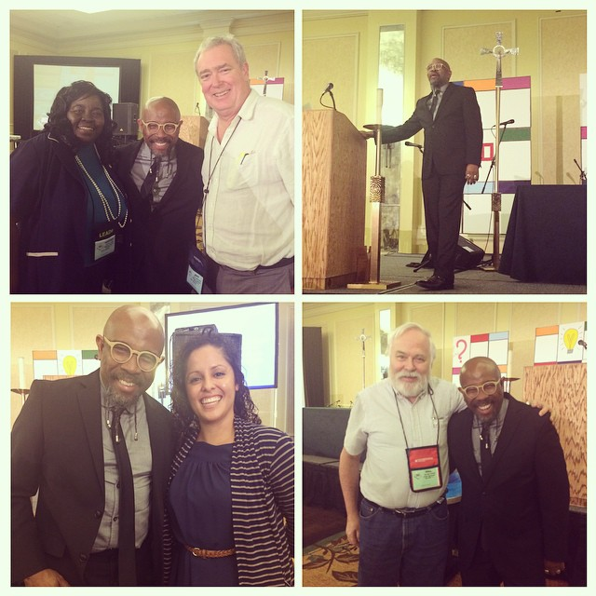
MILLENIAL INTERVIEW & DISCUSSION

Slide 5
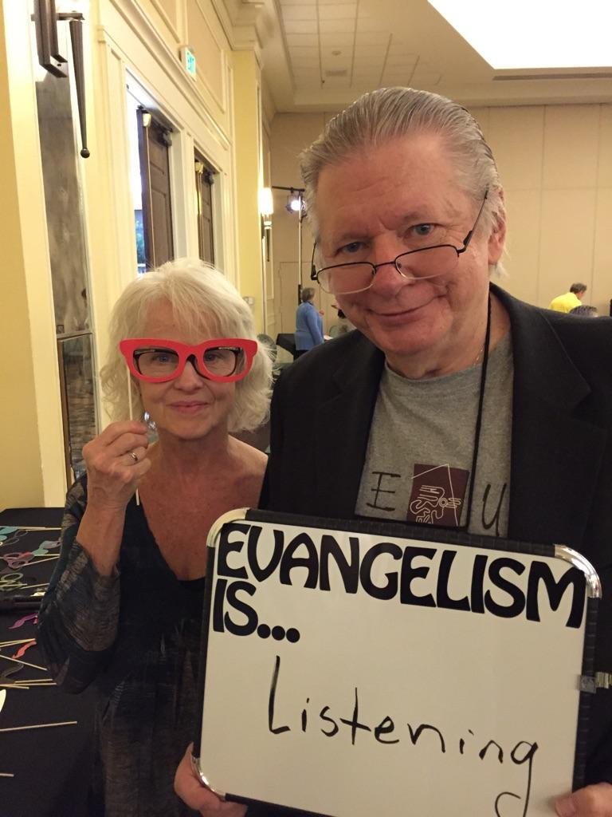
RUDY AND LUTHERHILL

Slide 6
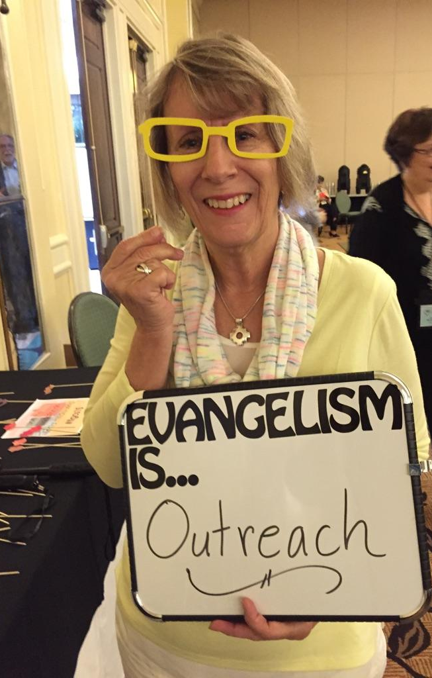
CAR AND PERU

Slide 7
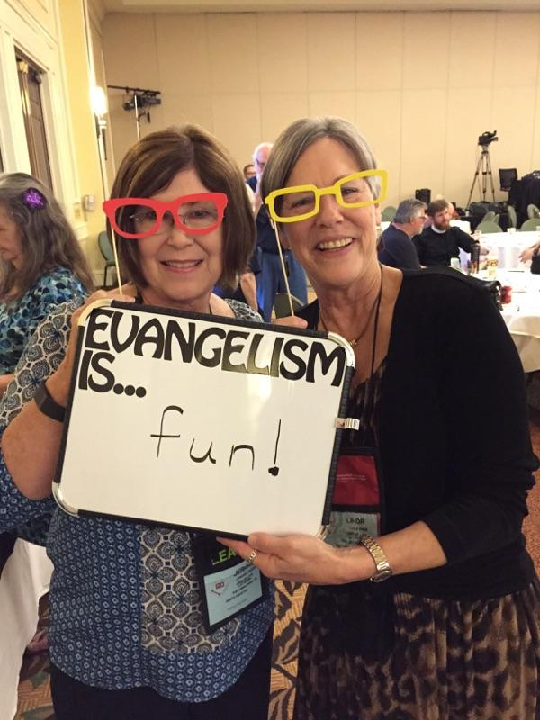
THE FIVE SPIRITUAL PRACTICES OF A HEALTHY CONGREGATION

Slide 8
BUDGET CELEBRATION & WORSHIP

