Slide 1
Session 2: Share
Holding Your Family Together with…

Slide 2
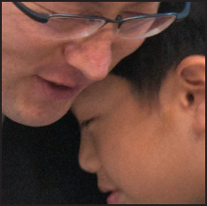
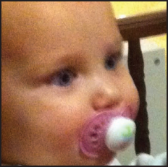
is a simple, easy-to-implement faith practice, perfect for incorporating into your bedtime routine in five to fifteen minutes a night. When done over time, FAITH5 carries the power to enrich communication, deepen understanding, aid sleep, and promote mental, physical and ^{spiritual health.}
^{The five steps are:}

Slide 3
SHARE
your highs and lows

Slide 4
READ
a Bible verse or story

Slide 5
TALK
about how the Bible reading might relate to your highs and lows

Slide 6
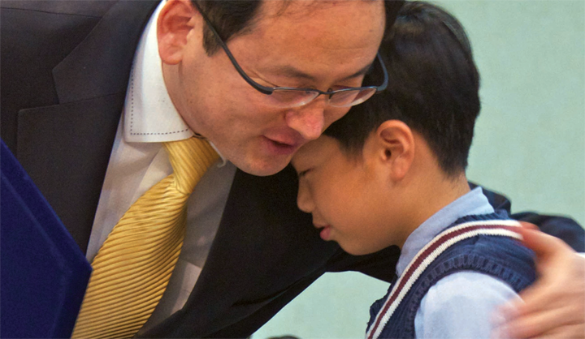
PRAY
for one another’s highs and lows

Slide 7
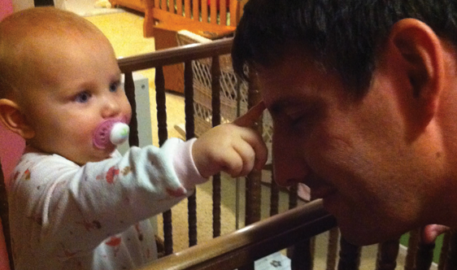
BLESS
one another

Slide 8
Today’s Theme

Slide 9
SHARE
your highs and lows

Slide 10
SHARE
your highs and lows
Start 1 on 1 with a partner
After a few minutes, gather with another pair and share your partner’s highs and lows

Slide 11
READ
this week’s theme verse together

Slide 12
“Where can I go from your spirit? Or where can I flee from your presence? If I ascend to heaven, you are there; if I make my bed in Sheol, you are there.”
^{Psalm 139:7-8}
SHARE

Slide 13
TALK
about how the Bible reading might relate to your highs and lows, then….

Slide 14
Appetizer Questions
What does it do for a child to share highs and lows in the context of a loving family or a group of trusted friends?
How might the sharing of joys and hurts, concerns and dreams, values and faith enrich a family?

Slide 15
Main Course
https://faithink.com/share/rich
Listen to what Dr. Rich has to say about the psychological benefits of sharing highs and lows each night. Play a clip, then pause and invite comments before showing the next.
Psychology of Highs (2:42)
Psychology of Lows (2:18)

Slide 16
Dessert Reflection
A. Put on a psychologist’s hat for a moment. What happens to a person when they:
Share a significant “high” with a trusted friend?
Share a significant “low” with a trusted friend?
B. Put on a sociologist’s hat for a moment. What happens to a family when they:
Reflect on the significant “highs” of the ^{day together every night?}
Reflect on the significant “lows” of the ^{day together every night?}

Slide 17
Dessert Reflection
Put on a theologian’s hat for a moment.
What happens to God’s world when every child goes to sleep knowing they are loved, heard and valued?
Why might sharing highs and lows at the end of each day be the optimal time for caring conversations, faith talk and reflection? (As compared to mornings, after school, in the car or around the dinner table.)

Slide 18
“Your word is a lamp to my feet and a light ^{to my path.”}
^{Psalm 119:105}
READ

Slide 19
Main Course
https://faithink.com/read/rich
Listen to what Dr. Rich has to say about how the wisdom, depth and wonder of God’s Word can enrich your family each night. Play a clip, then pause and invite comments before showing the next.
Read Overview (3:14)
What Does God’s Word Do? (2:53)

Slide 20
Dessert Reflection
^{What} ^{happens to a person when they…}
Read and reflect on God’s Word every day?
Make their home a “house of the Lord” every night?
Reflect on God’s Word just prior to going to sleep every night?

Slide 21
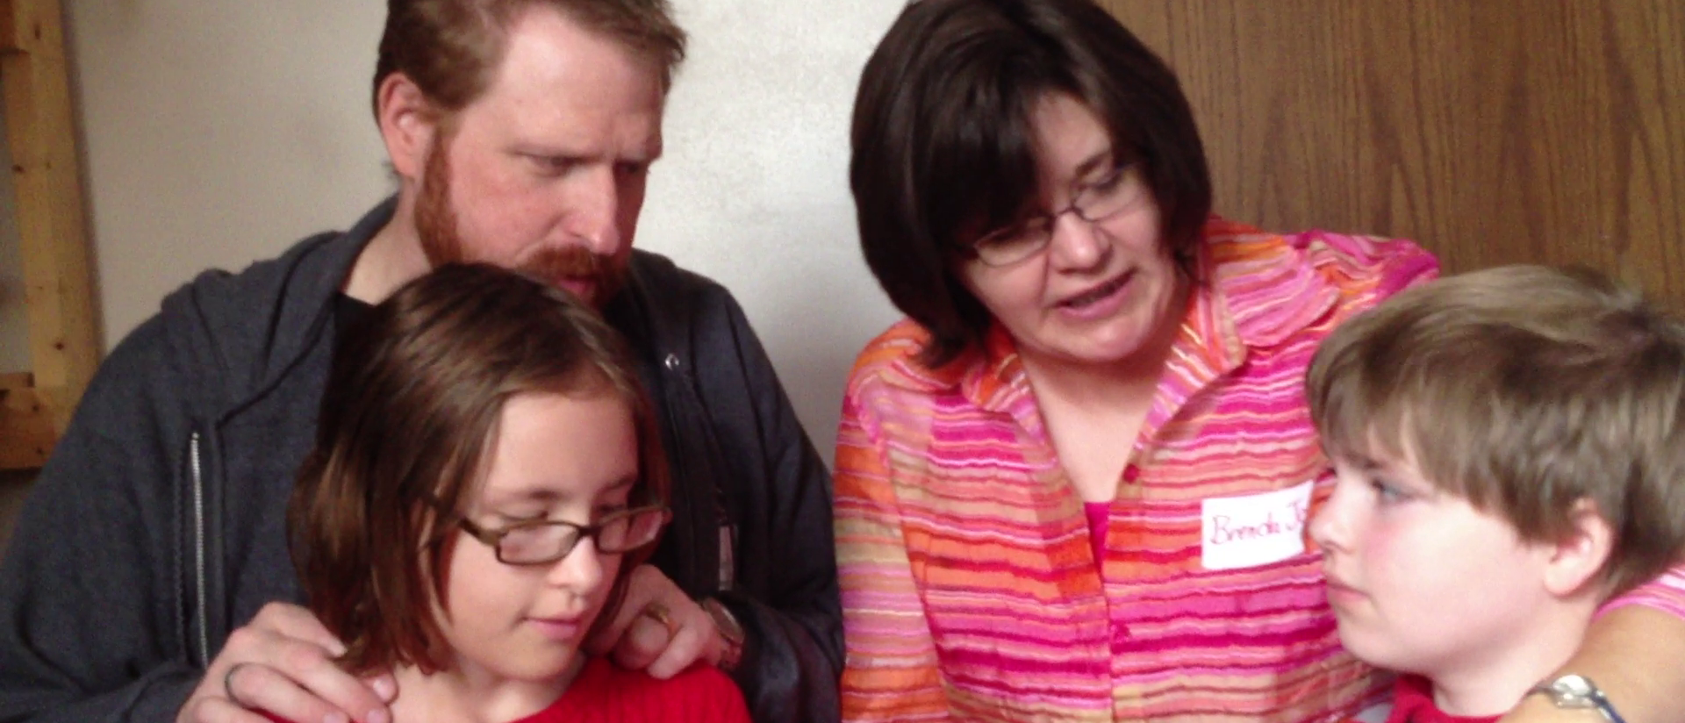
One Family’s Story
Watch this week’s story about the Gillund family. Discuss how the FAITH5 structure helps them through their challenges.
https://faithink.com/read/story

Slide 22
Wrap Up Reflection
Share one of these thoughts with the whole group
One new thing I learned today
One thing I already knew that is worth repeating
One thing I’d like to know more about

Slide 23
PRAY
Hold hands in a circle
Praise and thank God for a friend’s high
Ask the Holy Spirit for help with a friend’s low
Close in Jesus’ name

Slide 24
BLESS
Mark one another with the sign of the cross and say…
(Name), child of God, may God be with you in your highs and lows.
(Add a hug if you dare!)

Slide 25
This Week’s Home Huddle Challenge
Read chapter 1, STEP 1: SHARE and chapter 2, STEP 2: READ, in the Holding Your Family Together book.
Journal your highs, lows and prayers every night using the Home Huddle Journal in the course workbook. Come back next time ready to share your experience.
Watch some of the Online Extras at www.faith5.org.
Visit the FAITH5 Facebook page and post a question or share a comment.

Slide 26
Next Week’s Theme
Session 3: SHARE
Copyright © http://www.Faith5.org & Faith Inkubators www.faithink.com

